Slide 1
How to best use these slides…
View the PPT as a slide show
Then click through every step
Mouse clicks will advance the slide show
Left/right arrow keys move forward/backward
Mouse wheel scrolling moves forward/backward
When a question is posed, stop and think it through, try to answer it yourself before clicking
If you have questions, use PS discussion boards, email me, and/or visit us in a Teams class session!

Slide 2
AP 2009 Tile Game FRQ Problem

Slide 3
The problem:
Below is a link to the FRQ problems from 2009.
Please take time to read through pages 9-12 for the TileGame problem.
Page 9: basic problem info, and class outline for the supporting class NumberTile
Page 10: class outline for the problem class TileGame
Page 11: problem part A instructions
Page 12: problem part B instructions
Make sure you come back when you are done!
We will next walk through the problem including solving it.
2009 FRQ Problems

Slide 4
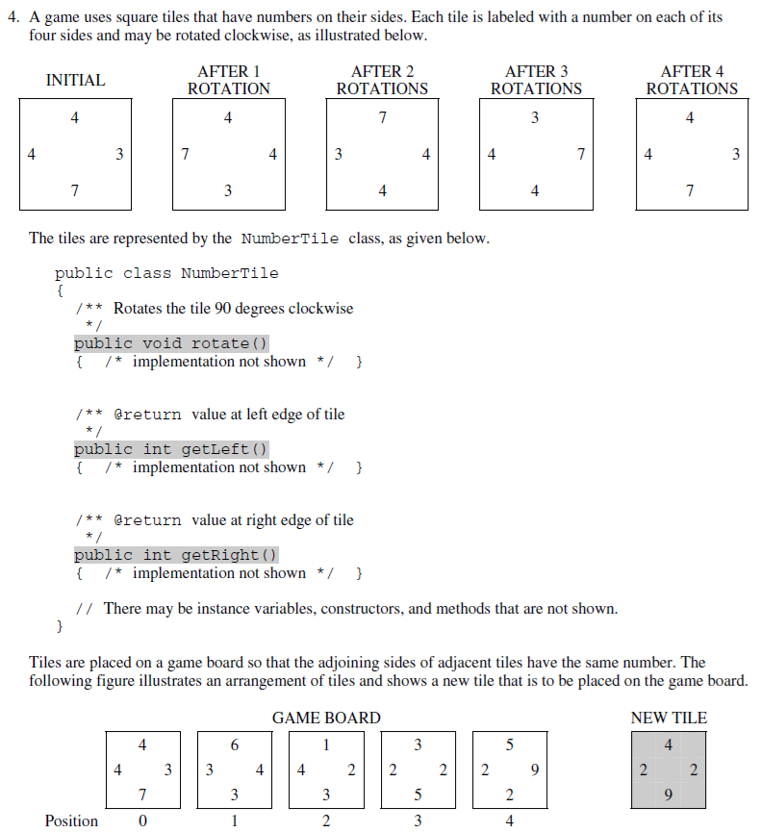
Page 9: Problem Description
Game tiles:
A game with square tiles
A tile has a number on each side
Tiles are rotated clockwise
Game board:
Tiles are set side-by-side in a row
Touching sides must have the same number
tile 0 right == tile 1 left
tile 1 right == tile 2 left
…etc.
Supporting class:
Encapsulates a tile
We do not write code for this class
Provided 3 tile methods:
rotate() – 90 deg clockwise
getLeft() – get left side #
getRight() – get right side #

Slide 5
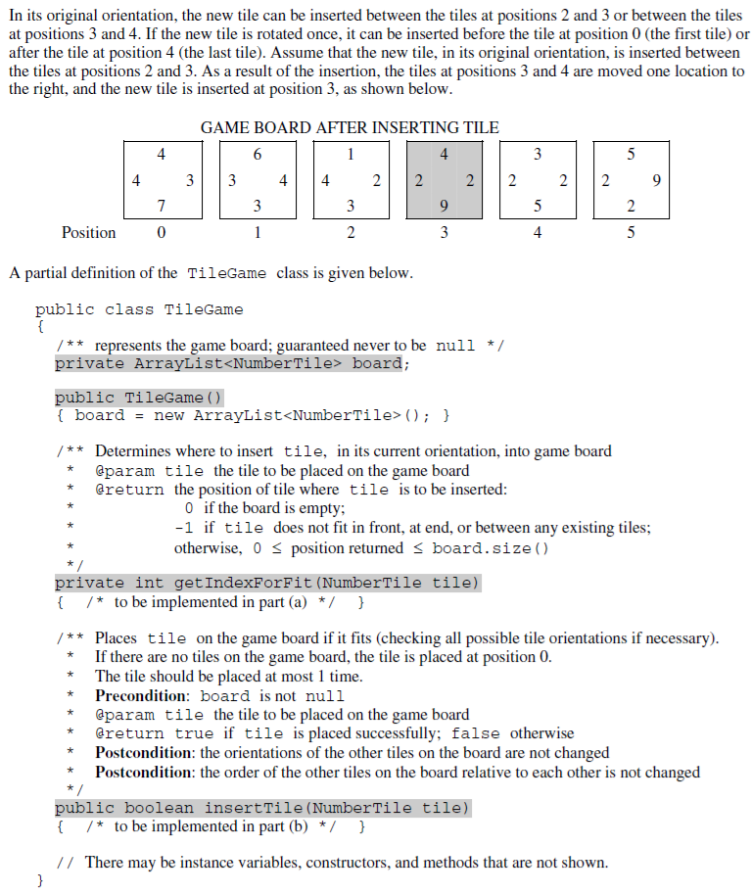
Page 10: Main Class:
Note how the description doesn’t give all the info we need
Here you need to carefully read the comment headers for the methods to get the rest of the info
We have 2 methods to write:
getIndexForFit()
insertTile()
getIndexForFit()
Returns index where the given tile should be inserted
Does NOT insert the tile
Returns 0 if board is empty
Returns -1 if can’t insert
Returns index of position this tile can be inserted at
insertTile()
Actually inserts the tile
Rotate tile as necessary to fit
Hint: USE getIndexForFit()
Page 10: Example + Main Class
Example (continued from pg 9):
Tile from pg 9 is shown inserted between old tiles 2 & 3
The new tile is now tile 3
There are multiple places it could be placed
btwn tiles 2 & 3
btwn tiles 3 & 4
Choose the first placement match
The description implies you can rotate the tile to insert it.

Slide 6
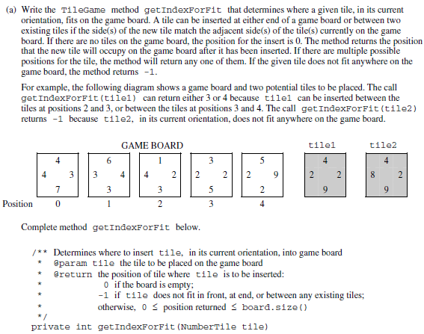
Page 11: part A problem
getIndexForFit()
Read the description
Read the method header
Together they give the full picture
We are NOT inserting in this method
We are figuring out where it would go
IN ITS CURRENT ORIENTATION
Return the index where it would go:
If board is empty: return 0
If can’t fit: return -1
Can be inserted at front or back
If multiple fit spots can return any
How we going to do this?
Our return must deal with “edge” conditions:
An empty board
Doesn’t fit
We can tell at the start if the board is empty
But must search the full list to tell if no fit
So first pass at our plan:
Handle empty board case: return 0
Can also check for fit before 1st here
Look for a fit between
This will be a loop
return index as soon as found
Handle didn’t fit case: return -1
Second pass at our plan
if board.size() == 0 OR fits before tile 0
return 0
Loop through tiles going forward
start with tile 1
end with last tile
if fit btwn this tile and one before
return this index
If fits after last tile
return length
Else return -1
…like now, read it
Read the example
Trying to insert two tiles
Tile 1:
2 possible positions
btwn 2 & 3
btwn 3 & 4
…can choose either
I assume we’ll be looping fwd so pick 1st
…so we’d return 3 because the new tile would be in position 3
Tile 2:
Doesn’t fit anywhere
Return -1
…like now, read it

Slide 7
The code for part A!
public int getIndexForFit(NumberTile tile) {
if ( board.size() == 0
return 0;
}
for ( int i = 1 ; i < board.size() ; i++ ) {
if ( board.get(i-1).getRight() == tile.getLeft() && tile.getRight() == board.get(i).getLeft() ) {
return i;
}
}
if ( board.get(board.size()-1).getRight() {
== tile.getLeft() )
return board.size();
else {
return -1;
}
}
|| tile.getRight() == board.get(0).getLeft() ) {
int i = 1
i < board.size()
getIndexForFit() plan:
if board.size() == 0
return 0
Loop through tiles going forward
start with tile 1
end with last tile
if fit btwn this tile and one before
return this index
If fits after last tlle
return length
Else return -1
OR fits before tile 0

Slide 8
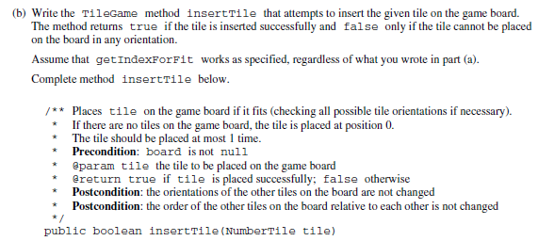
Page 12: part B insertTile()
Actually insert the given tile if possible
return true if successful
false otherwise
We are to rotate as necessary to find a fit
There are at most 4 possible orientations
Note the placement rules are the same as for part A getIndexForFit()
Also note they’ve given a hint to use method getIndexForFit()
Important pre & post conditions to note
Plan
Try all 4 orientations, start with the current one
This will be a loop, 4 iterations
Check current orientation: getIndexForFit()
If it fits
Add it
And return true
Otherwise rotate the tile
And keep trying
If get to end of loop, no orientation worked,
Return false
I will leave it up to you to read the:
Problem description
Method header

Slide 9
The code for part B!
public boolean insertTile(NumberTile tile) {
for ( int rotation = 0 ; rotation < 4 ; i++ ) {
int i = getIndexForFit(tile);
if ( 0 <= i && i <= board.size() ) {
board.add(i, tile);
return true;
}
tile.rotate();
}
return false;
}
insertTile() plan:
Try all 4 orientations, start with the current one
This will be a loop,
Check current orientation: getIndexForFit()
If it fits
Add it
And return true
Otherwise rotate the tile (last step in loop)
…and keep trying
If get to end of loop, no orientation worked,
Return false
int rotation = 0
rotation < 4
4 iterations
getIndexForFit() returns
-1 if can’t place it
0 <= and <= board.size() if can place it

Slide 10
Homework Assignment
See the class website assignment page!
Got a bunch of problems on Codingbat.org to do.
Have fun!

